Slide 1
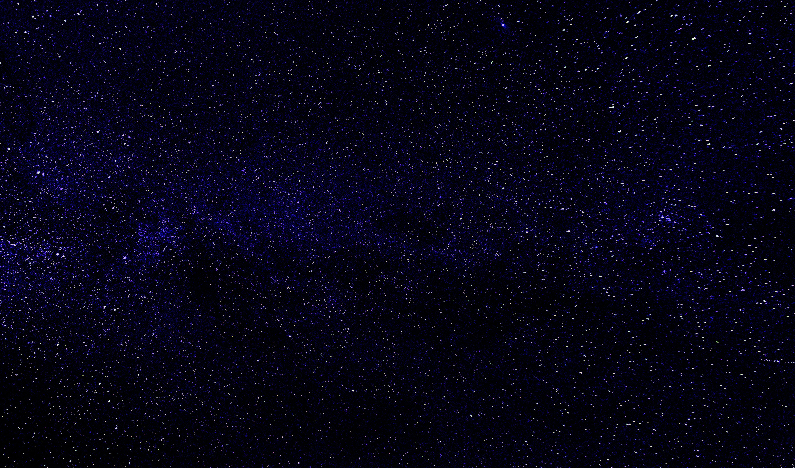

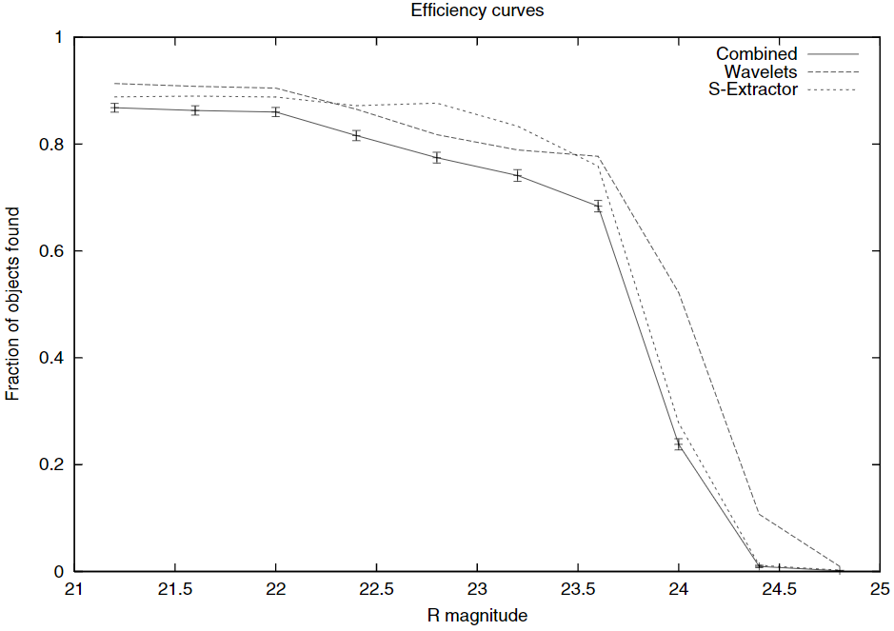
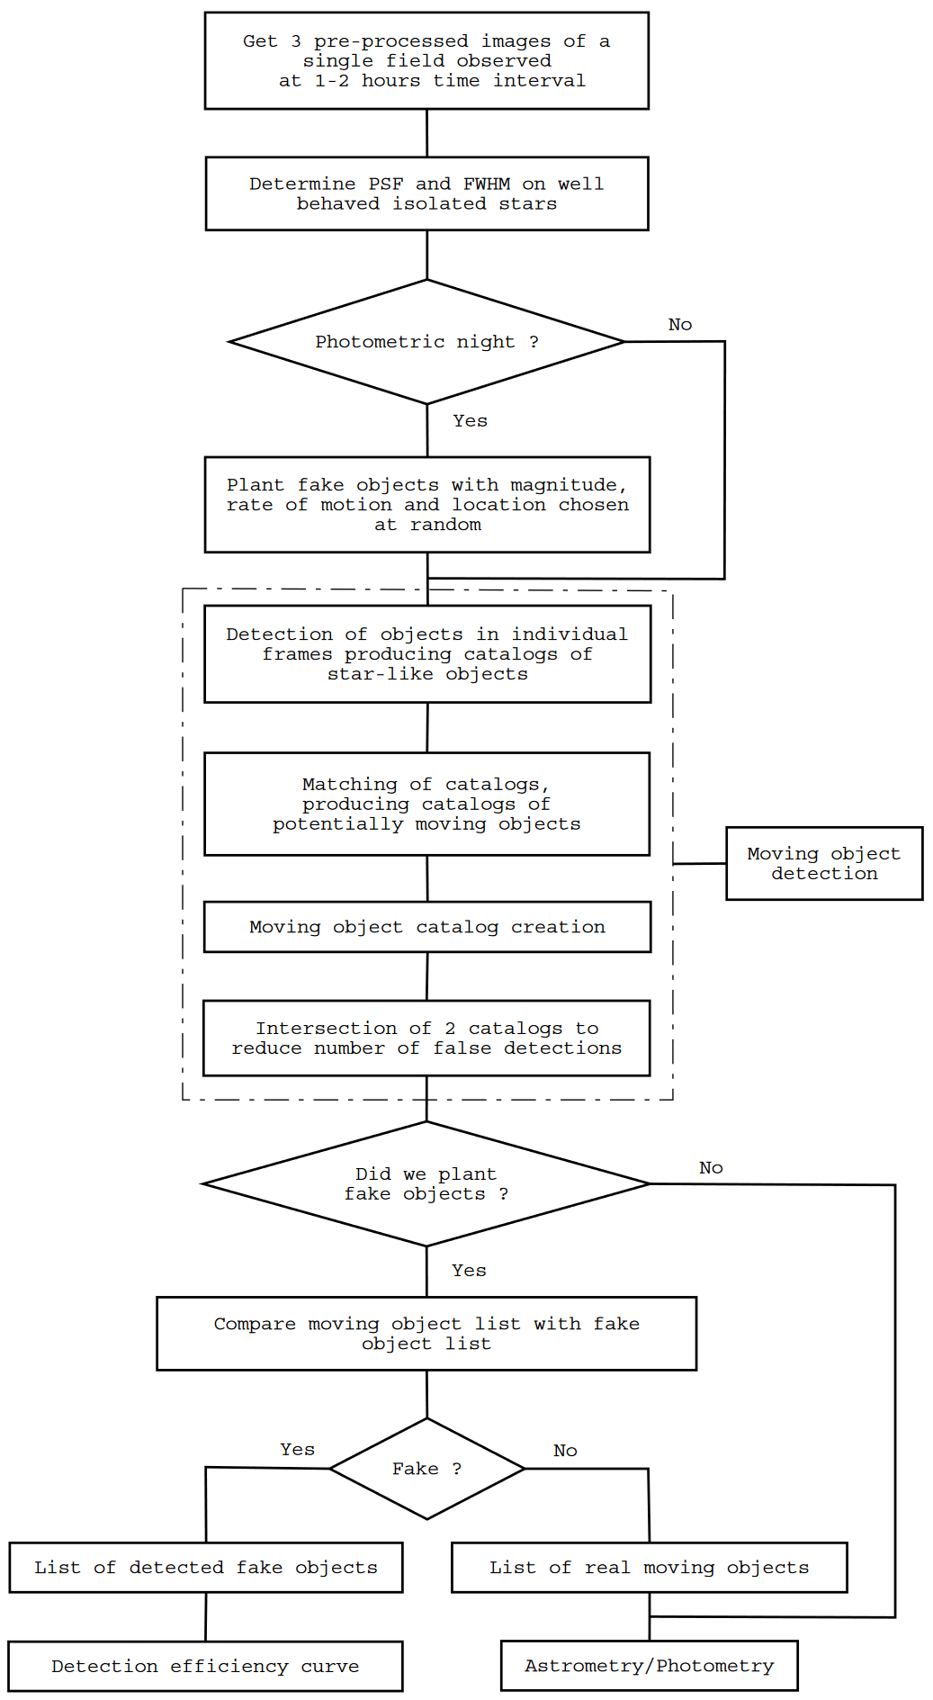
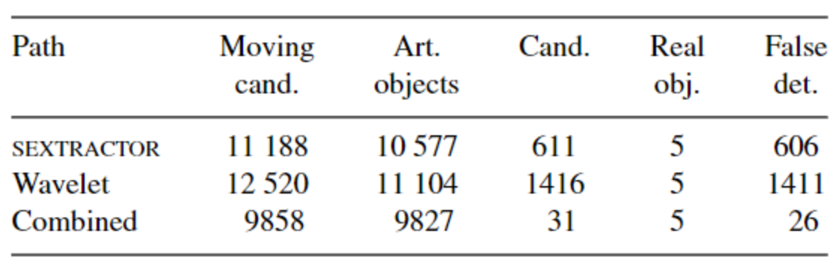
TNO’s efficiency determination by Machine Learning
Project performed by M. Vincent Foriel, supervised by M. Jean-Marc Petit
Student project powered by the Université de Bourgogne Franche-Comté
Abstract
Methodology
Conclusion
Due to their high magnitude, Trans-Neptunian Objects (TNO) are very difficult to observe. To detect them, the use of image processing algorithms is necessary to sort out the thousands of light sources, observable on a telescope image, in order to make the confirmation task humanly feasible (Table 1). These algorithms must eliminate most of the false detections, while letting through as many real objects as possible. One needs then to determine how efficient is this process. The methods developed so far to determine this efficiency do not scale easily with the data load of the next generation surveys. Then, the angle of attack is to exploit a Machine Learning algorithm in which we will have previously introduced the various parameters that can determine this efficiency, then to train this algorithm to find the efficiency that we have already obtained on the pictures processed so far by the current methods. From there, if the algorithm manages to find the expected efficiencies, we will then be able to study the weight given to each of the parameters in order to have a more precise idea of the elements that influence the detection efficiency.
Initially, my objective will be to think about all the parameters that can be obtained from the images and that can influence the detection efficiency. Once this list has been drawn up, I will have to understand how Machine Learning algorithms work in order to be able to create one, by defining these different parameters. The nature of the algorithm is still uncertain. It will be able to either take input from the images, or from the data describing the image, depending on the parameters influencing the detection efficiency. This algorithm will also undergo many modifications, mainly concerning the parameters it will consider, and will be trained as many times as necessary until
What are the parameters that can influence the detection efficiency of the TNO and the method to obtain it? This is an open question that this project will try to answer. It is therefore an exploration project on which there are many unknowns. There is not guaranteed that the angle chosen is the right one. Indeed, it is possible that the algorithm will not be able to produce conclusive results. In this case, we will know that this approach is not efficient, and this will still allow us to move forward!
it is able to produce an efficiency curve that we expect (Fig. 2). If a result seems conclusive in the time allotted to me, then I should study the weight that the algorithm has given to the different parameters and try to establish a formula, or at least a clear procedure to obtain this efficiency.
Table 1 Comparison of the number of candidate produced by 2 différents méthodes, for data taken in 2002 November,with the upgraded CFH12K camera, extracted from the paper “A highly automated moving object detection package” by J-M Petit et al. (2004)
Fig. 2 Comparison of the efficiency curves for the 2 différents existing méthodes, for data taken in 2002 November,with the upgraded CFH12K camera, extracted from the paper “A highly automated moving object detection package” by J-M Petit et al. (2004)
Introduction
Acknowledgement & more
TNO detection algorithms are voluntarily very selective, and their efficiency must be determined in order to be able to correctly estimate the fraction of objects that the algorithm has been able to detect, and thus to have a better idea of the real population of objects. Currently, the method used consists in adding false objects with various magnitudes on the input images of the algorithm, and then comparing in output the number of false objects that the algorithm was able to detect with the number of objects implemented (Fig. 1). However, to be accurate, this method requires the implementation of many false objects. However, adding too many objects in an image modifies the global properties of the image, which can lead to important biases. This problem forces to add few objects, but to perform the analysis many times by adding each time different objects. This method works well but has the disadvantage of being computationally heavy and can significantly slow down the detection process. With the arrival of new generations of telescopes like the LSST, covering a large part of the sky, it becomes necessary to develop new methods to solve these new needs.
This first poster was mainly made using the following article:
Petit J.-M., Holman M., Scholl H. et al. (2004). A highly automated moving object detection package. M Monthly Notices of the Royal Astronomical Society, Vol. 347, p. 471–480. http://cdsweb.u-strasbg.fr
But other related articles allow to get a better overview of this topic and the challenges:
Petit J.-M., Holman M.J., Gladman B.J. et al. (2006). The Kuiper Belt luminosity function from mR = 22 to 25. Monthly Notices of the Royal Astronomical Society, Vol. 365, p. 429–438. https://doi.org/10.1111/j.1365-2966.2005.09661.x
Bannister M.T., Kavelaars J.J., Petit J.-M. et al. (2016). The outer solar system origins survey. I? Design and first-quarter discoveries. The Astronomical Journal, Vol. 152, p. 70-95. https://doi.org/10.3847/0004-6256/152/3/70
Bannister M.T., Gladman B.J., Kavelaars J.J. at al. (2018). OSSOS. VII. 800+ Trans-Neptunian Objects—The Complete Data Release. The Astrophysical Journal Supplement Series, Vol. 236, p. 18-37. https://doi.org/10.3847/1538-4365/aab77a
Iorio L., Smith J.A., Bazso A., Lawler S.M et al. (2018). OSSOS: X. How to Use a Survey Simulator: Statistical Testing of Dynamical Models Against the Real Kuiper Belt. Frontiers in Astronomy and Space Sciences, Vol. 5, Article 14. https://doi.org/10.3389/fspas.2018.00014
Fig. 1 Schema of the method that allow to get information about the detection efficiency, extracted from the paper “A highly automated moving object detection package” by J-M Petit et al. (2004)

Slide 2
TNO’s efficiency determination by Machine Learning
Project performed by M. Vincent Foriel, supervised by M. Jean-Marc Petit
Student project powered by the Université de Bourgogne Franche-Comté
Abstract
Introduction
Methodology
Due to their high magnitude, Trans-Neptunian Objects (TNO) are very difficult to observe. To detect them, the use of image processing algorithms is necessary to sort out the thousands of light sources, observable on a telescope image, in order to make the confirmation task humanly feasible (Table 1). These algorithms must eliminate most of the false detections, while letting through as many real objects as possible. One needs then to determine how efficient is this process. The methods developed so far to determine this efficiency do not scale easily with the data load of the next generation surveys. Then, the angle of attack is to exploit a Machine Learning algorithm in which we will have previously introduced the various parameters that can determine this efficiency, then to train this algorithm to find the efficiency that we have already obtained on the pictures processed so far by the current methods. From there, if the algorithm manages to find the expected efficiencies, we will then be able to study the weight given to each of the parameters in order to have a more precise idea of the elements that influence the detection efficiency.
TNO detection algorithms are voluntarily very selective, and their efficiency must be determined in order to be able to correctly estimate the fraction of objects that the algorithm has been able to detect, and thus to have a better idea of the real population of objects. Currently, the method used consists in adding false objects with various magnitudes on the input images of the algorithm, and then comparing in output the number of false objects that the algorithm was able to detect with the number of objects implemented (Fig. 1). However, to be accurate, this method requires the implementation of many false objects. However, adding too many objects in an image modifies the
Initially, my objective will be to think about all the parameters that can be obtained from the images and that can influence the detection efficiency. Once this list has been drawn up, I will have to understand how Machine Learning algorithms work in order to be able to create one, by defining these different parameters. The nature of the algorithm is still uncertain. It will be able to either take input from the images, or from the data describing the image, depending on the parameters influencing the detection efficiency. This algorithm will also undergo many modifications, mainly concerning the parameters it will consider, and will be trained as many times as necessary until it is able to produce an efficiency curve that we expect (Fig. 2). If a result seems conclusive in the time allotted to me, then I should study the weight that the algorithm has given to the different parameters and try to establish a formula, or at least a clear procedure to obtain this efficiency.
global properties of the image, which can lead to important biases. This problem forces to add few objects, but to perform the analysis many times by adding each time different objects. This method works well but has the disadvantage of being computationally heavy and can significantly slow down the detection process. With the arrival of new generations of telescopes like the LSST, covering a large part of the sky, it becomes necessary to develop new methods to solve these new needs.
Table 1 Comparison of the number of candidate produced by 2 différents méthodes, for data taken in 2002 November,with the upgraded CFH12K camera, extracted from the paper “A highly automated moving object detection package” by J-M Petit et al. (2004)
Fig. 2 Comparison of the efficiency curves for the 2 différents existing méthodes, for data taken in 2002 November,with the upgraded CFH12K camera, extracted from the paper “A highly automated moving object detection package” by J-M Petit et al. (2004)
Acknowledgement & more
Conclusion
This first poster was mainly made using the following article:
Petit J.-M., Holman M., Scholl H. et al. (2004). A highly automated moving object detection package. M Monthly Notices of the Royal Astronomical Society, Vol. 347, p. 471–480. http://cdsweb.u-strasbg.fr
But other related articles allow to get a better overview of this topic and the challenges:
Petit J.-M., Holman M.J., Gladman B.J. et al. (2006). The Kuiper Belt luminosity function from mR = 22 to 25. Monthly Notices of the Royal Astronomical Society, Vol. 365, p. 429–438. https://doi.org/10.1111/j.1365-2966.2005.09661.x
Bannister M.T., Kavelaars J.J., Petit J.-M. et al. (2016). The outer solar system origins survey. I? Design and first-quarter discoveries. The Astronomical Journal, Vol. 152, p. 70-95. https://doi.org/10.3847/0004-6256/152/3/70
Bannister M.T., Gladman B.J., Kavelaars J.J. at al. (2018). OSSOS. VII. 800+ Trans-Neptunian Objects—The Complete Data Release. The Astrophysical Journal Supplement Series, Vol. 236, p. 18-37. https://doi.org/10.3847/1538-4365/aab77a
Lawler S.M., Kavelaars J.J., Alexandersen M. et al. (2018). OSSOS: X. How to Use a Survey Simulator: Statistical Testing of Dynamical Models Against the Real Kuiper Belt. Frontiers in Astronomy and Space Sciences, Vol. 5, Article 14. https://doi.org/10.3389/fspas.2018.00014
What are the parameters that can influence the detection efficiency of the TNO and the method to obtain it? This is an open question that this project will try to answer. It is therefore an exploration project on which there are many unknowns. There is not guaranteed that the angle chosen is the right one. Indeed, it is possible that the algorithm will not be able to produce conclusive results. In this case, we will know that this approach is not efficient, and this will still allow us to move forward!
Fig. 1 Schema of the method that allow to get information about the detection efficiency, extracted from the paper “A highly automated moving object detection package” by J-M Petit et al. (2004)

